Slide 1
Managed care
HSPM J712

Slide 2
Old system
Independent self-employed doctors
Paid fee-for-service
Not hospital employees
Hospitals
Before aseptic surgery, hospitals were places for poor people to go to die.
Or get free care (“dispensaries”)
Then became doctors’ workshops
Built by philanthropic organizations (non-profit)
Or doctors as owners (for-profit)

Slide 3
Old system
Insurance
Blue Cross trademark owned by American Hospital Association
A pre-payment collection agency for the hospitals
Blue Shield added for doctors
Buick was “the doctor’s car”

Slide 4
Fee-for-service with 3rd-party payer
Doctors and hospitals
Insurance
Patient

Slide 5
Prepaid group practice system
Doctors
Hospitals
Insurance
Patient

Slide 6
Capitation
A fixed amount of money per person per year to pay for health care
Caput is Latin for head

Slide 7
Incentives in opposite directions
Fee-for-service payment
Capitation
Gives the provider an incentive to do more
Contrary to the insurer’s incentive
Gives the provider an incentive to do less
In line with the insurer’s incentive

Slide 8
How to align the doctor’s incentive with the insurer
Make the doctor a partner – prepaid group practice
Utilization control – rules on what insurer will pay for
Bonuses and penalties -- IPAs
All three are used by “managed care” and by “health maintenance organizations”

Slide 9
Mayer, T.R., and Mayer, G.G., "HMOs: Origins and Development"
N Engl J Med, February 28, 1985, 312, pp. 590-594.
Prepaid group practice, the precursor of HMOs.
Early prepaid group practice doctors had to fight medical societies.
First prepaid group practice remembered today began ~ 1910 in Tacoma, Washington. Two docs contracted with lumber firms to provide care for workers for a capitation payment of 50 cents per month. Grew to a chain of 20 clinics in Washington and Oregon.

Slide 10
First HMOs and insurance
1927 – first prepaid hospital care.
In Elk City, OK, a doc built a community hospital by selling shares to finance construction. Shareholders ($50/each) got free care at the hospital. [Inspired by stock market boom, not Depression.]
1929 – first hospitalization insurance. School teachers could pay $0.50/month and get free care at the Baylor Hospital in Dallas.

Slide 11
Medical Societies vs. the HMOs
Prepaid practice -- a threat. Locks patients.
Elk City medical society ejected the doc. The state licensing board tried to take away his license. No consultations with docs who practiced at that hospital.
Meantime, the doc toured the country during the 1930s and '40s encouraging farmers to set up similar plans.
One of those plans was the Group Health Cooperative of Seattle, that later was used in the RAND experiment (Ware article). It, too faced medical society opposition, which led to a court battle that the med soc lost in 1957.

Slide 12
Medical Societies vs. the HMOs
Other early capitation clinics were in Los Angeles (1929), where docs were also ejected from med soc.
1930s Oregon doctors boycotted hospitalization insurance plans, but soon ...
What to do about capital requirements beyond what an individual doctor could afford? Non-profit hospitals, at which doctors are not employees, but are "staff" with decision-making power.
The AMA embraced Blue Cross (Baylor plan) as an preferable alternative to prepaid group capitated practice.

Slide 13
HMO history
Other early HMOs:
the Group Health Plan of Washington DC (1937),
Kaiser plan in California (1942),
HIP of NY (1944).
1970 -- about 30 HMOs
1975 – about 166 HMO

Slide 14
Kaiser-Permanente
Kaiser
Hospitals
Other facilities
Permanente
Doctors

Slide 15
Government encouraged HMOs
States exempted HMOs from insurance regulation
For insurance companies, regulation is to guarantee solvency. States require reserves.
Prepaid group practice -- little or no cash reserve required.
Rationale: Prepaid practice pays in service, not in money.

Slide 16
Government encouraged HMOs
Nixon Administration (early 1970s) supported HMOs.
Market alternative to national health insurance. (
The term "HMO" was coined by Paul Ellwood in 1971 to appeal to Nixon.)
Liberals saw HMOs as a way that a national health insurance system could be managed.
HMOs were the basis for 1993 Clinton plan.

Slide 17
IPA HMO growth
The 1973 law
Subsidies for HMO start-up
Required employers providing health insurance to allow employees to join a Federally qualified HMO if one existed in their area.
HMO definition in law included
Prepaid Group Practices
IPAs (Independent Practice Associations)
also called Foundations
IPAs were docs' attempts to compete with PPGPs while maintaining independence.
IPAs grew and spread faster than prepaid group practices.

Slide 18
PPO growth
PPOs (Preferred Provider Organizations) control cost with less provider control than in HMOs.
PPOs select providers based on cost of practice
PPOs use differential copayments to induce patients to see a preferred provider.

Slide 19
Paying for out-of-plan services
No -- "closed panel."
Closed panel HMOs do pay for services of outside doctors for patients who have exotic conditions that the HMO panel cannot handle, if specifically authorized by the HMO.
Yes -- "open panel."
A fully open panel HMO would be a contradiction in terms. Compare PPOs.
"Gatekeeper" method:
A primary care doc must pre-approve specialist visits to specialists. The "Gatekeeper" can approve out-of-plan services (but has incentive not to).

Slide 20
Go to HMO types slide show

Slide 21
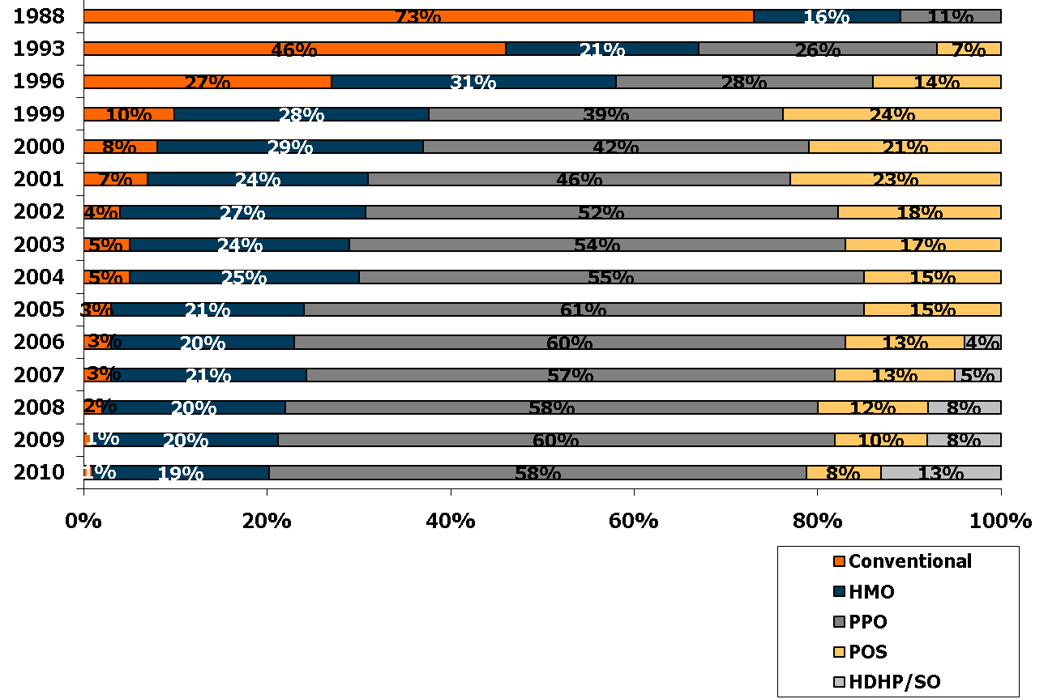
Distribution of Health Plan Enrollment for Covered Workers, by Plan Type, 1988-2010
*
*
*
*
*
*
* Distribution is statistically different from the previous year shown (p<.05). No statistical tests were conducted for years prior to 1999. No statistical tests are conducted between 2005 and 2006 due to the addition of HDHP/SO as a new plan type in 2006.
Note: Information was not obtained for POS plans in 1988. A portion of the change in plan type enrollment for 2005 is likely attributable to incorporating more recent Census Bureau estimates of the number of state and local government workers and removing federal workers from the weights. See the Survey Design and Methods section from the 2005 Kaiser/HRET Survey of Employer-Sponsored Health Benefits for additional information.
Source: Kaiser/HRET Survey of Employer-Sponsored Health Benefits, 1999-2010; KPMG Survey of Employer-Sponsored Health Benefits, 1993, 1996; The Health Insurance Association of America (HIAA), 1988.

Slide 22
“A Controlled Trial of the Effect of a Prepaid Group Practice on Use of Services,” Willard G. Manning, Ph.D., Arleen Leibowitz, Ph.D., George A. Goldberg, M.D., William H. Rogers, Ph.D., and Joseph P. Newhouse, Ph.D., N Engl J Med 1984; 310:1505-1510 June 7, 1984
Utilization: Prepaid group practice compared with fee-for-service

Slide 23
PPGP vs FFS utilization
RAND randomly assigned 1580 persons to receive care free of charge from either a fee-for-service physician of their choice (431 persons) or the Group Health Cooperative of Puget Sound (1149 persons). In addition, 733 prior enrollees of the Cooperative were studied as a control group.

Slide 24
PPGP vs FFS utilization
Results:
40% fewer hospital admissions for both groups at the Cooperative, in comparison with the fee-for-service group (P<0.01)
Ambulatory-visit rates were similar.
25% less spending all services in the two Cooperative groups, compared with the fee-for-service group. (P<0.01 for experimental group, P<0.05 for control group).
More preventive visits in the Cooperative groups.

Slide 25
PPGP vs FFS by RAND
The two Coop groups used similar services. Since one of those groups was randomly assigned by RAND, it’s likely that the RAND fee-for-service group had similar health risks to the group of people already in the Coop.
Therefore: The Coop’s lower costs are not due to risk selection.
Conclusion: Medicine at the prepaid group practice was much less hospital-intensive and, consequently, less expensive.

Slide 26
PPGP vs FFS hospital utilization
Siu, A.L., Leibowitz, L., Brook, R.H., Goldman, N.S., Lurie, N., Newhouse, J.P., "Use of the Hospital in a Randomized Trial of Prepaid Care," JAMA, March 4, 1988, 259, pp. 1343-1346.

Slide 27
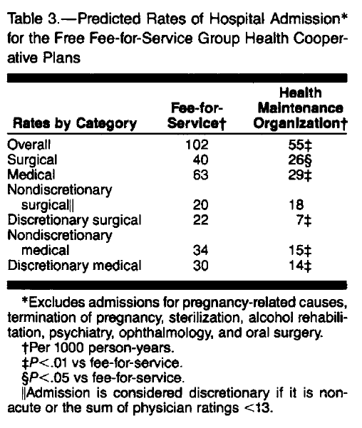

Slide 28
PPGP vs FFS Outcomes
Ware, J.E., et al, "Comparison of Health Outcomes at a Health Maintenance Organisation with Those of Fee-for-Service Care," Lancet, May 3, 1986, pp. 1017-1022.
1673 individuals ages 14 to 61 were randomly assigned for 3-5 years to one prepaid group practice or to a free care FFS plan in Seattle, Washington.

Slide 29
PPGP vs FFS Outcomes (Ware)
For non-poor individuals who were initially in good health, outcomes were similar.
Outcomes differed among people who started with health problems.
Among the high-income initially-sick, Coop patients showed more improvement in cholesterol levels and in general health ratings than did the free FFS care patients.

Slide 30
PPGP vs FFS Outcomes (Ware)
Among the low-income initially-sick, the Coop patients had more bed-days per year due to poor health and more serious symptoms than the patients with free FFS care. Coop patients had a greater risk of dying.
RAND-paid Coop patients did not get the Coop’s outreach program for low-income subscribers.

Slide 31
Later HMO/FFS outcome difference study
Ware, J.E., Bayliss, M.S., Rogers, W.H., Kosinski, M., Tarlov, A.R., "Differences in 4-Year Health Outcomes for Elderly and Poor, Chronically Ill Patients treated in HMO and Fee-for-Service Systems," JAMA, October 2, 1996, 276(13), pp. 1037-1047.

Slide 32
Ware 1996
4-year observational study of 2235 patients (18 to 97 years of age) with
hypertension,
non-insulin-dependent diabetes mellitus (NIDDM),
recent acute myocardial infarction,
congestive heart failure,
depressive disorder
sampled from HMO and FFS systems in 1986 and followed up through 1990.

Slide 33
Average physical health declined and mental health remained stable during the 4-year follow-up period
Physical declines were larger for the elderly than for the nonelderly (P<.001).
For elderly patients, aged 65+ and on Medicare,
Declines in physical health were more common in HMOs than in FFS plans (54% vs 28%; P<.001).
Mixed results for mental health outcomes
Outcomes favored FFS over HMOs for the poor
Outcomes favored HMOs over FFS for the non-poor.

Slide 34
Forms of HMO “Health Maintenance Organization”
Legal relationship between HMO and docs may be:
Docs own the HMO as, e.g., stockholders or partners.
Prepaid group practice, also called "staff model."
Docs can be salaried and also be partners.
The Permanente medical group (the doctor half of Kaiser Plan) does this
or
HMO contracts with docs, who maintain private practices
Independent Practice Association (IPA)

Slide 35
Other forms of managed care
PPO -- Preferred Provider Organization
Has a panel, but the PPO pays a share of costs for services rendered by providers not on the panel.
Providers in the panel are "preferred" by the PPO; it pays a higher percentage of the cost for their services.
POS -- Point of Service -- plans seem the same as PPOs to me.

Slide 36
Following diagrams from
Bodenheimer and Grumbach, Capitation or Decapitation

Slide 37
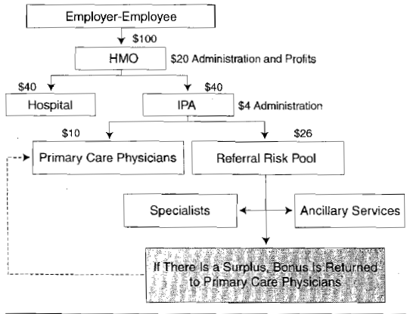

Slide 38
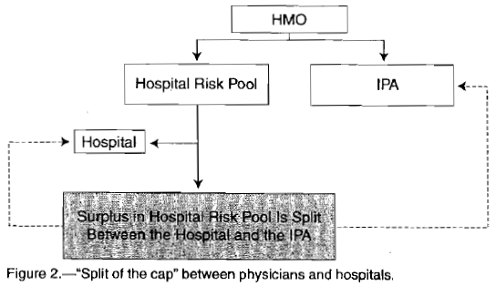

Slide 39
Health Maintenance Organization
Capitation’s advertised incentive
Maintain enrollee’s health
Capitation’s other incentives
Selection
Screen out costly enrollees
Scrimping on care

Slide 40
Incentive
HMO
Fee-for-service
Doctors have incentive to give less care.
Is prevention encouraged?
Doctors have incentive to give more care.
Is prevention encouraged?
Which is worse for patient trust in the doctor?

Slide 41
Do HMOs gain by investing in prevention?
Prevention that saves more than it costs
Prevention that does not save more than it costs
Long-term care not covered, so HMO doesn’t gain by reducing it
Subscriber can change jobs. Benefits of prevention accrue to the new insurer.
The public gains from prevention, but the private insurer does not.
Prevention attracts subscribers willing to pay more for quality

Slide 42
Trust?
A principal-agent problem
FFS – pays provider to do more than you need
HMO – pays provider to do less than you need

Slide 43
Next slide from
THE MEDICARE-HMO REVOLVING DOOR — THE HEALTHY GO IN AND THE SICK GO OUT
Robert O. Morgan, Beth A. Viring, Carolee A. DeVito, and Nancy A. Persily, NEJM 1997

Slide 44
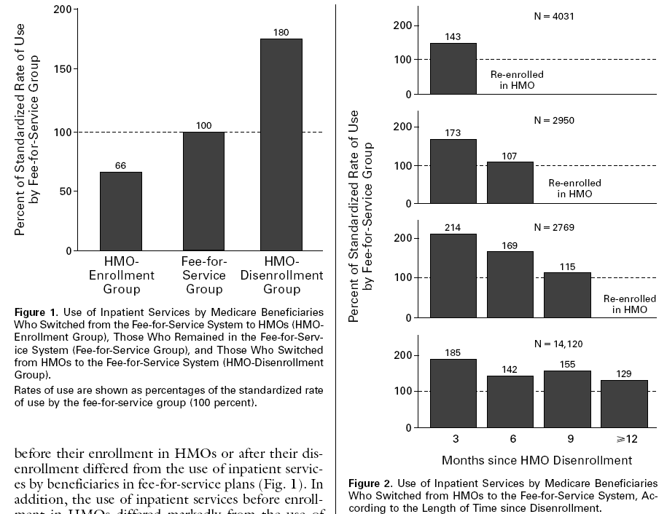

Slide 45
Medicare overpaid Medicare HMOs
Selective enrollment of healthier beneficia- ries before 2004 -- “old cherry-picking.”
Gaming the risk-adjustment scheme, the Hierarchical Condition Categories (HCCs).
Congress mandated overpayments in the 2003 Medicare Prescription Drug, Improvement, and Modernization Act.

Slide 46
Medicare overpaid Medicare HMOs
Full payment for veterans, even when the vet gets service from the VHA
Future: Quality bonus payments from the $8.35 billion CMS “Medicare Advantage Quality Bonus Payment Demonstration” could offset 1/3 of the ACA’s elimination of third item.
See near end of pdf

Slide 47
How health insurance competition is working
http://articles.latimes.com/2006/sep/17/business/fi-revoke17
http://www.calnurses.org/media-center/press-releases/2009/september/california-s-real-death-panels-insurers-deny-21-of-claims.html
http://www.consumerreports.org/health/insurance/health-insurance/overview/health-insurance-ov.htm

