Slide 1
Money and the current depression
HSPM 714 J50

Slide 2
How a depression can happen
If people take money out of circulation, a depression can happen
Demand does not keep up with Supply
These are total “aggregate” demand and supply
Not a technological failure
Not solvable by retraining the unemployed
Not a moral failure
Not solvable by punishing the unemployed

Slide 3
How to relieve a depression
The government can relieve a depression by seeing to it that people spend more money
One way to do that is to give out money

Slide 4
How a depression can be relieved
Inflation from giving out money?
The DC Babysitting coop had fixed prices
Inflation not possible
but effects resembling inflation could happen – like people with coupons not being able to find a willing babysitter

Slide 5
Too many certificates?
Equity in babysitting requires members not be flooded with certificates
How many times you can go out = How many times you’ve babysat + how many certificates the committee gave you
If everyone has all the certificates they expect to need, the certificates are worthless
Functional equivalent of inflation

Slide 6
The problem of giving out money
Money tied to morality
People who work hard for their money resent giveaways
So we look for excuses to give out money
“deserving” people
Government contracts and hiring to do something useful

Slide 7
Cynical point about the wealthy and depressions: Which of these makes a person with a lot of cash happier?
Depression scenario
Inflation scenario
Lots of people are out there who are willing to work for you when you like in return for one of your many coupons.
When you ask somebody to work for you, they say, “No thank you, I already have enough coupons.”

Slide 8
Babysitting coop as a model economy with special limitations
One commodity, plus money
(Common in macroeconomic models)
The special limitations:
Fixed price – fixed value of a certificate
No borrowing or lending
These limitations are two sides of the same coin

Slide 9
Real economies have lending and borrowing
Credit older than coins
In ancient and medieval economies
Most transactions on credit
Even when prices reckoned in weights of gold or silver
Lending and borrowing – credit and debt – creates money
During debt crises, money disappears

Slide 10
Money and banking
The U.S. does have lending and borrowing
which can expand or contract the money stock.
Our committee in charge of money is the Federal Reserve System
which can manipulate the financial system to affect how much money people and institutions are borrowing and lending, which affects how much is being spent in any period of time.

Slide 11
Money supply and banks
The amount of money in the U.S. is not determined by a central authority like the DC coop board.
Banks determine the money supply through their individual decisions about how much to lend.
Fractional reserve banking (lending from deposits) makes for a fragile system.

Slide 12
What is a bank?
Banks borrow short-term and lend long-term.
This makes banks inherently unstable.
Short-term borrowing means that the bank promises to pay out funds to depositors on short notice.
Long-term lending means that the bank lends money to people who do not promise to pay back the bank on short notice.

Slide 13
Fractional reserve banking
The medieval goldsmith’s racket
Holds gold for people
Lends it out
Reserves cover expected redemptions

Slide 14
Fractional reserve banking
Reserves to cover expected redemptions
Normal times
Extraordinary times (panics)
Relying on self-regulation – unstable system
It’s always tempting to lend more
Where there is regulation, banks find ways to lend outside of the regulated area

Slide 15
Banks’ inherent instability
Why banks affect the trappings of stability
Nobody’s being fooled. Depositors know that the goldsmith is lending the gold.
The goldsmith may offer the depositors free storage or interest payments in return for being allowed to lend out the gold.
A rumor – such as that the bank’s creditors can’t pay their loans – can lead to a run on the bank.
The rumor doesn’t have to be true. Depositors may know it to be false. But a run can start if some depositors think that a run might start.

Slide 16
Panic = Bank runs leading to bank runs
In the U.S.
1819
1837
1857
1873
1893
1907
1930

Slide 17
Panics => Money disappears => Depressions
In the U.S.
1819 – 2 years
1837 – 6 years
1857 – 2 years
1873 – 5 years
1893 – 4 years
1907 – 4 years
1930 – 10 years

Slide 18
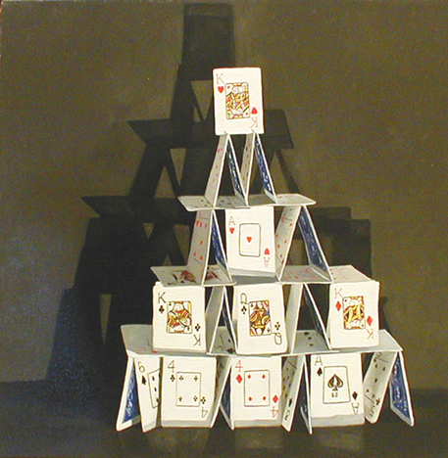
Private credit expansion can create a house of cards

Slide 19
You can identify immediate causes
1819 – cotton prices fell
1837 – wheat crop failed
1857 – railroads overbuilt
1873 – railroads overbuilt
1893 – stock market collapsed
1907 – stock speculation failed
1930 – stock market collapsed late 1929
But it’s like looking for causes for the collapse of a house of cards.

Slide 20
19th century banking regulation – public and private
“National banks” 1864
Open books to the U.S. Treasury
Local “clearinghouses”
Banks formed pools, agreed to pay off each others’ depositors

Slide 21
“Banks” and banks
Or, banks and shadow banks
A shadow bank is something that acts like a bank but is not called a bank and is not subject to regulation
Evading bank regulation – building bigger but flimsier houses of cards – a recurring theme in banking history

Slide 22
Runs / Panics
Worried depositors demand their money
Banks stop lending, call in loans
Businesses can’t get loans, go broke
Their suppliers lose business, can’t pay off their loans either
Banks have more bad loans, more depositors panic
Money disappears

Slide 23
Panic of 1907
“Trusts” – shadow banks in New York City – took deposits from rich individuals
Started in the 1880’s
Low-risk investments at first, but, after 1900, got more into real estate and the stock market
National banks weren’t allowed there
Didn’t join the New York Clearinghouse
That the national banks were in
Members had to meet reserve requirements

Slide 24
“Trusts” could pay higher returns than national banks
No reserve requirements
Could invest in ways the U.S. Treasury wouldn’t allow
By 1907, these shadow banks were as big as the national banks, in total assets

Slide 25
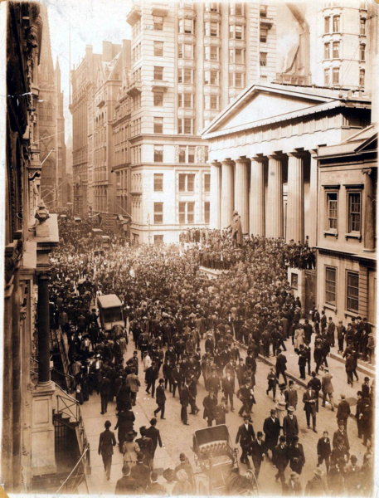
The Panic
One trust company tried to corner the copper market and failed, taking a big loss
One national bank learned of this and announced that it would not accept checks drawn on that trust company
Depositors ran to the trust company to get their money out

Slide 26
The Panic
The New York Clearinghouse refused to help
In two days, runs closed 12 trust companies
Stock market collapsed
Banks wouldn’t lend
People needed money

Slide 27
Rich guys rescue
J. P. Morgan promised is own money and organized the banks to stop the panic in a few days.
There were some aftershocks, but more bankers pitched in and the banks stabilized.
But, banks had called in loans, and got careful about new lending =>
many bankruptcies,
Industrial production fell, unemployment rose

Slide 28
Even with a gold standard …
… there can still be
Inflation
Depression
… because fractional reserve banking makes the money stock flexible and responsive to the expectations of people with money

Slide 29
Ban fractional reserve banking?
“If banks are outlawed, only outlaws will have banks.”
Krugman

Slide 30
Like a house of cards
You can look for specific causes of specific crashes
But the big idea is that you have something that can crash at any time

Slide 31
The Federal Reserve, 1913
Monetary policy
Reserve requirements
Banks’ reserves are accounts at a regional Federal Reserve bank
Rather than gold or currency in a vault
Overnight loans of reserves to banks at an interest rate that the Fed sets
The Fed buys and sells government bonds
from and to the largest banks

Slide 32
The Federal Reserve
“Prints money”
by lending reserves
and
buying government bonds

Slide 33
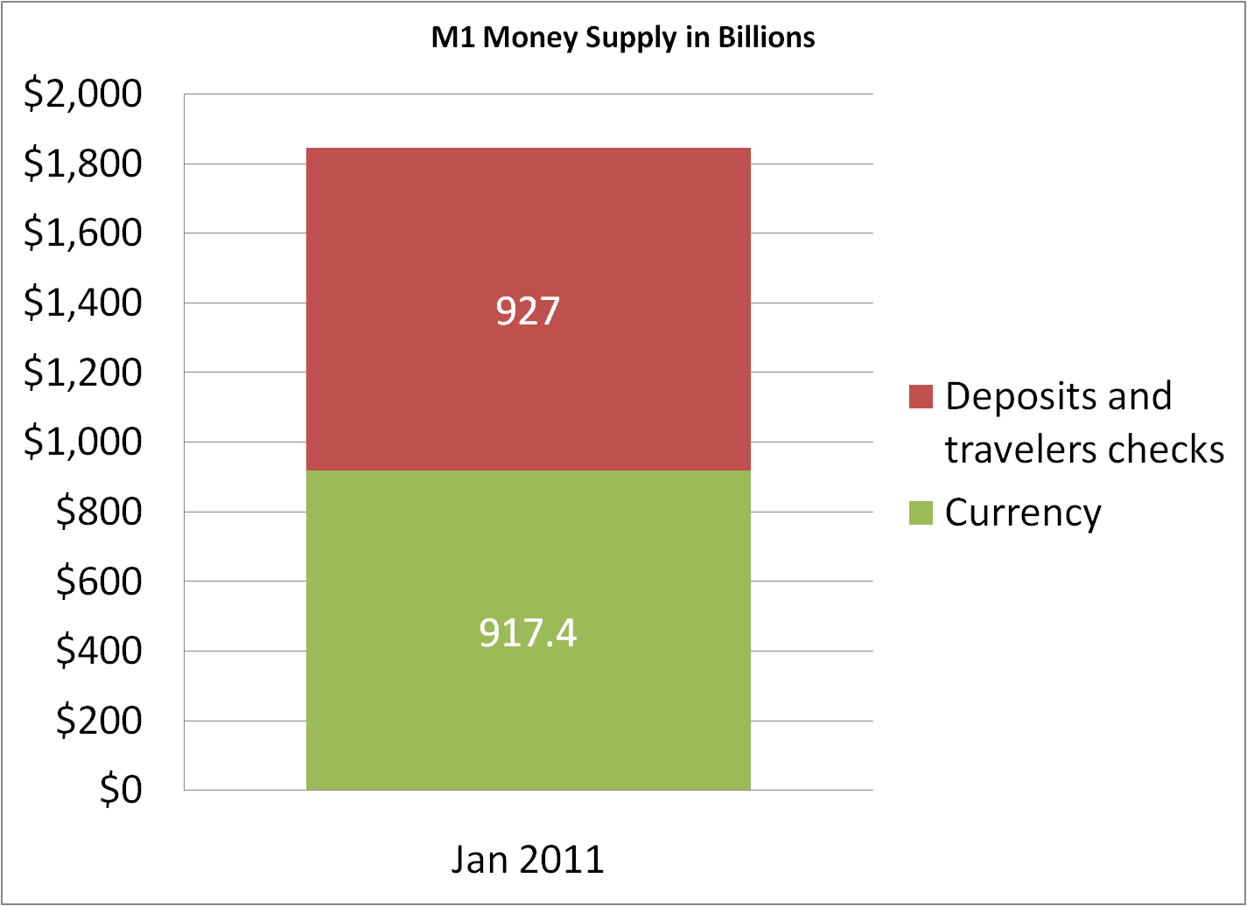

Slide 34
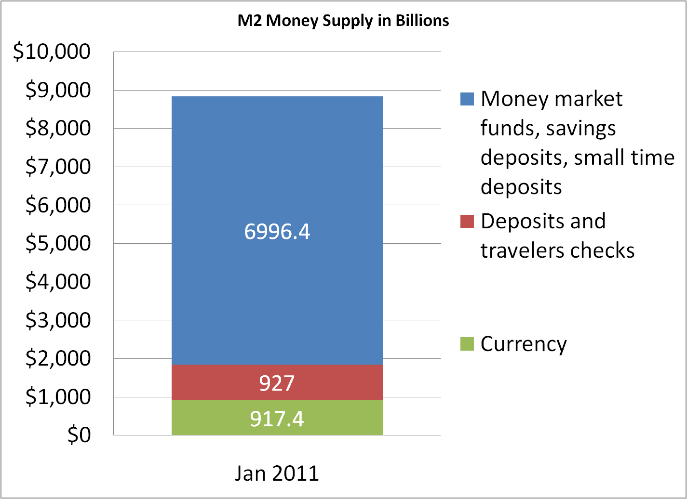
“Money supply”

Slide 35
1920’s expansion of banking again
Stock speculation
Banks bought stocks with depositor money
Banks lent money to buy stocks “on margin”
Buying stock “on margin” using borrowed money: The stock is the collateral. If the value of the stock falls, the buyer must come up with cash.

Slide 36
Stock market crash, 1929
As stock prices fell, margin calls forced investors to raise cash, which prompted more stock sales.
Bank loans to buy stocks went bad, led to runs on banks
Many people lost their savings, forcing reductions in spending
Businesses couldn’t sell, couldn’t borrow. Unemployment ensued.

Slide 37
How can monetary policy help during a downturn?

Slide 38
Easier money can boost economy
Lending in the DC babysitting co-op model
From one person to another
From the central authority

Slide 39
Fed “open market operations”
If Fed buys government bonds
The price of the bonds tends to rise
Lowers the IRR of the bonds
Makes interest rates fall
If Fed sells government bonds
The price of the bonds tends to fall
Raises the IRR of the bonds
Makes interest rates rise

Slide 40
Fed “open market operations”
If Fed buys government bonds
The banks that sold the bonds now have cash
The supply of loanable funds is higher
The government is borrowing less from the banks
The demand for loans, private+public, is less.
Interest rates (the prices to borrow money) fall
If Fed sells government bonds
The banks that buy the bonds give up cash
The supply of loanable funds is lower
The government is borrowing more
The demand for loans is more.
Interest rates rise

Slide 41
Interest rates and boosting the economy
The effect of a falling interest rate on a net present value

Slide 42
Liquidity trap Trap = monetary policy ineffective
The Fed cut interest rates
But prices were falling and goods were unsold, because people weren’t spending
Interest rates went to near 0%, but private spending didn’t respond
Real interest rate = Interest rate – Inflation rate
If inflation rate < 0, the real interest rate is high, even if the interest rate is 0.

Slide 43
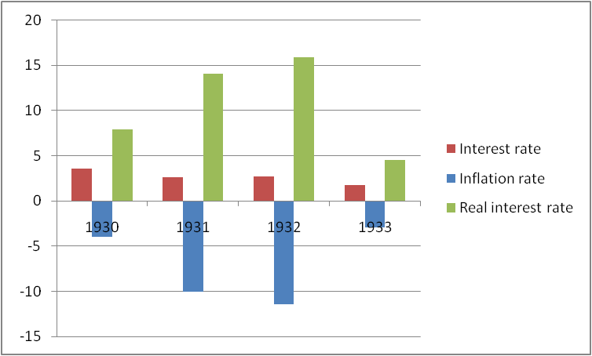
Liquidity trap

Slide 44
Deflation kills the NPV of an investment
The effect of a falling prices on a net present value

Slide 45
Monetary policy and fiscal policy
In depression in liquidity trap
Consumers aren’t spending
Business isn’t investing
Monetary policy ineffective -- interest rates can’t go lower than 0%
Only the government can spend
It can borrow (or tax) the money people and businesses are holding
And spend it to raise total spending

Slide 46
The Fed’s Assets

Slide 47
The Fed’s Assets

Slide 48
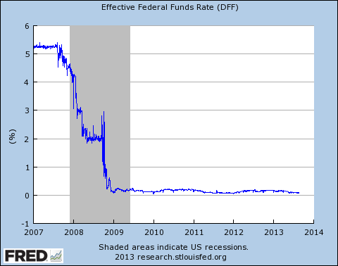

Slide 49
What solved the 1930s depression and could solve today’s depression
Giving out money
By lending it
By giving it away
By spending it

Slide 50
Government spending cured the 1930s depression
Public works – roads, dams, parks, rural electricity
Deficit hawks in 1937 led to downturn
World War II – big government spending for war production
The limited effect of lending: Fed buys securities, but banks just keep the money in reserve

Slide 51
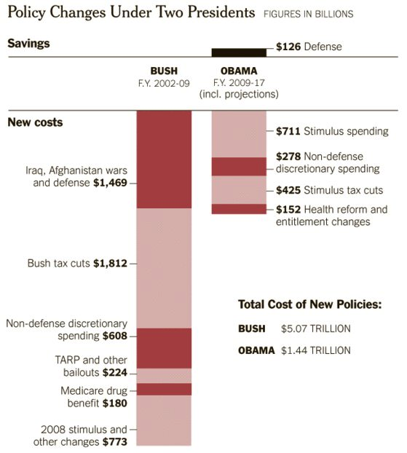

Slide 52
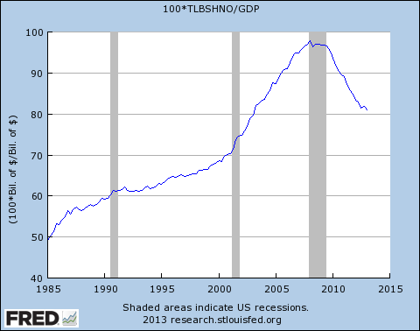
Household debt / GDP

Slide 53
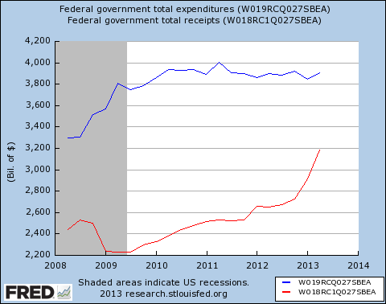

Slide 54
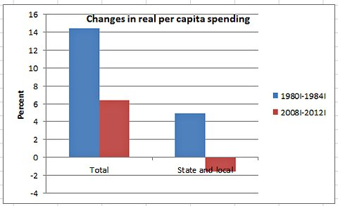

Slide 55
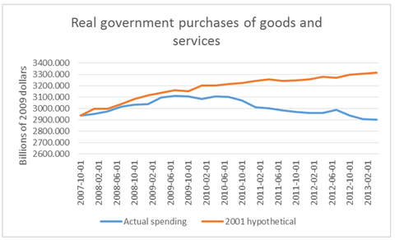

Slide 56
No immediate debt problem

Slide 57
Mark Troma http://www.thefiscaltimes.com/Columns/2013/09/24/Real-Reason-Fight-over-Debt-Limit#sthash.i8kwpgbd.dpuf
Rising inequality and differential exposure to economic risk has caused one group to see themselves as the “makers” in society who provide for the rest and pay most of the bills, and the other group as “takers” who get all the benefits. The upper strata wonders, “Why should we pay for social insurance when we get little or none of the benefits?” and this leads to an attack on these programs.
This political dispute over the debt limit is … an attempt by Republicans to use undue fear about the debt to scale back or eliminate spending on social insurance programs such as Medicare, Social Security, Obamacare, food stamps, and unemployment compensation.

Slide 58
Money and morality
Makers
Moochers
… but if a depression is a system failure, and not a moral failure

Slide 59
Moral hazard
Heads, they win. Tails, you lose.
Banks are tempted to skimp on reserves
Banks are tempted to lend to poor risks

Slide 60
Glass-Steagall Act, 1933
Deposit insurance
FDIC to guarantee small deposits in banks
FSLIC (came later) to guarantee deposits in savings banks and S&L’s
Boston’s Provident Institution for Savings, 1816
A new moral hazard
Separation of investment banking from taking deposits
Curtailed shadow banking by banks
75 years before the next big crash in the U.S.

